Slide 1
Basic Data Structures
Tuesday July 23: 2am – 4:30pm
Most generic data structure: Graphs.
More specific Graphs:
Singly Linked Lists, Doubly Linked Lists, Circular Doubly Linked Lists.
Trees.
Queues and Stacks.
Simulating algorithms with Graph Visualizer.

Slide 2
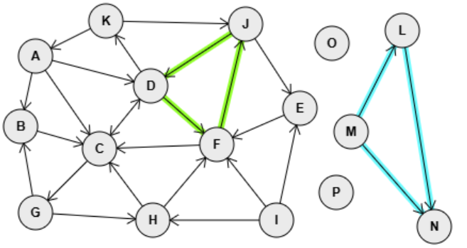
Basic Data Structures
Graphs
GPT/Copilot ⟩ What's the simplest, most generic definition of a graph in computer science?
In computer science, a graph is a data structure that consists of a set of nodes (also called vertices) and a set of edges that connect pairs of nodes. Graphs are used to represent relationships between objects.
A cyclic graph has at least one circuit leading back to a node already visited.
Each isolated node or group of nodes is called a graph partition.
A graph with only one partition is a connected graph.
A graph with more than one partition is a disconnected graph.
Some nodes can be isolated
In directed graphs, some edges point one way.
Some groups of nodes can be isolated from the nodes or groups of nodes.
Some nodes can point to each other. In undirected or bidirectional graphs all edges point both ways.
Graphs can be acyclic
Following the edges never leads back to the same node.
Notes:
A : 42,64 > D C B
B : 28,130 > C
C : 102,151 > D G
D : 150,92 > K F C
E : 290,113 > F
F : 212,147 > C J
G : 42,211 > B H
H : 152,218 > C F
I : 268,218 > F E H
J : 239,34 > D E
K : 108,31 > A J
L : 386,40 > N
M : 338,135 > L N
N : 416,224 >
O : 320,52 >
P : 324,192 >

Slide 3
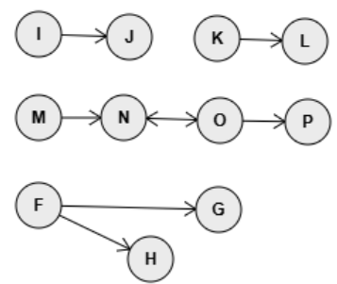
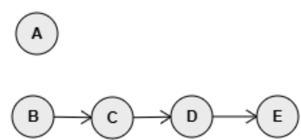
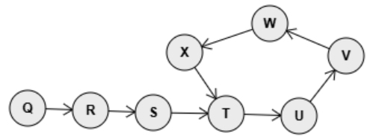
Basic Data Structures
Singly Linked Lists
...a form of specialized Graphs
GPT/Copilot ⟩ Describe a Singly Linked List as a specific type of Graph
A singly linked list can be viewed as a specific type of graph known as a directed acyclic graph (DAG). Here’s how:
Nodes (Vertices): Each element in the linked list is a node.
Edges: Each node has an edge pointing to the next node in the sequence.
Direction: The edges have a direction, from one node to the next.
Acyclic: There are no cycles; you cannot start at one node and follow the edges to return to the same node.
In essence, a singly linked list is a linear, directed graph where each node points to exactly one other node (except the last node, which points to null).
Valid Singly Linked Lists.
Invalid Singly Linked Lists.
head / tail
head
tail
Notes:
A : 63,56 >
B : 60,120 > C
C : 121,121 > D
D : 182,120 > E
E : 248,120 >
F : 212,334 > G H
G : 339,337 >
H : 291,372 >
I : 212,213 > J
J : 276,215 >
K : 338,216 > L
L : 400,218 >
M : 212,272 > N
N : 272,272 > O
O : 340,274 > P N
P : 402,275 >
Q : 416,440 > R
R : 472,442 > S
S : 528,444 > T
T : 593,445 > U
U : 658,447 > V
V : 700,393 > W
W : 632,364 > X
X : 556,390 > T

Slide 4
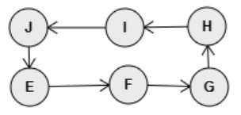

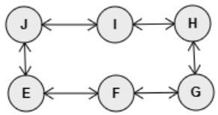
Basic Data Structures
Doubly Linked Lists
...a form of specialized Graphs
GPT/Copilot ⟩ Describe a Doubly Linked List as a specific type of Graph
A doubly linked list can be viewed as a specific type of graph with the following characteristics:
Nodes (Vertices): Each element in the doubly linked list is a node.
Edges: Each node has two edges: one pointing to the next node and one pointing to the previous node.
Direction: The edges are bidirectional, meaning you can traverse the list in both forward and backward directions.
Acyclic: There are no cycles; you cannot start at one node and follow the edges to return to the same node.
In essence, a doubly linked list is a bidirectional, linear, directed acyclic graph where each node points to both its successor and its predecessor (except for the first and last nodes, which point to null in one direction).
Valid Circular Singly Linked List but not a valid Doubly Linked List
Circular Doubly Linked Lists
...a form of specialized Doubly Linked Lists
Valid Doubly Linked List
Valid Circular Doubly Linked List
head
tail
head
Notes:
A : 58,97 > B
B : 124,98 > A C
C : 195,98 > B D
D : 269,98 > C
E : 116,245 > F J
G : 267,244 > H F
H : 264,183 > I G
I : 195,184 > J H
J : 114,184 > E I
F : 196,245 > G E

Slide 5
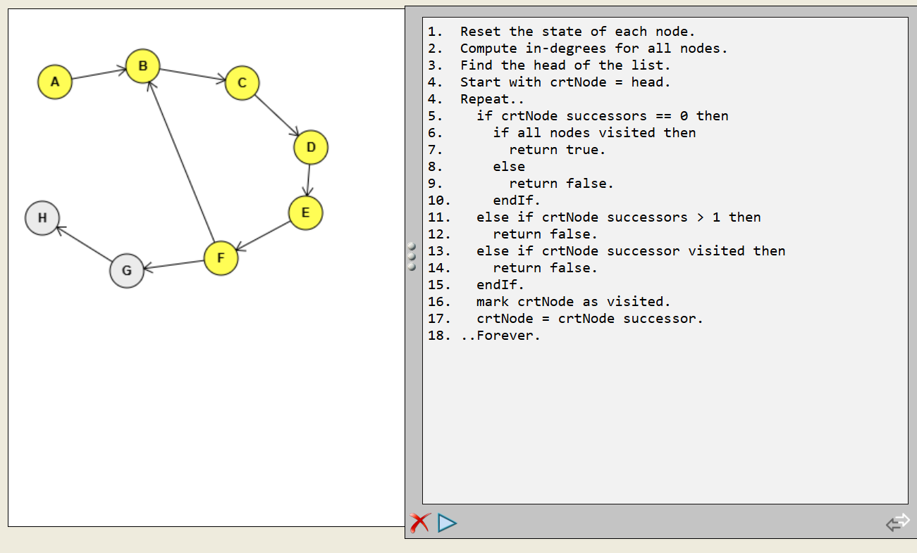
Basic Data Structures
Linked Lists
...a form of specialized Graphs
Determine if a generic Graph is a Singly Linked List.
Determine if a generic Graph is a Doubly Linked List.
Challenge: Determine if a generic Graph is a Circular Doubly Linked List
Notes:
A : 44,69 > B
B : 127,54 > C
C : 221,70 > D
D : 286,131 > E
E : 281,193 > F
F : 201,236 > G B
G : 112,248 > H
H : 32,198 >

Slide 6
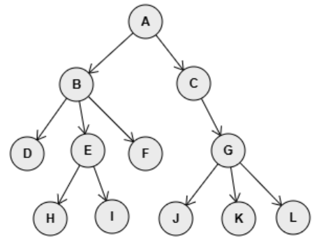
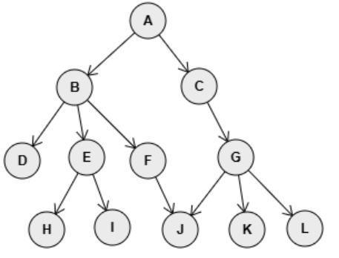
Basic Data Structures
Trees
...a form of specialized Graphs
GPT/Copilot ⟩ Describe a generic Tree as a specific type of Graph
A tree is a specific type of graph with the following characteristics:
Nodes (Vertices): Each element in the tree is a node.
Edges: Each node is connected to its children by edges.
Direction: The edges are directed from parent to child.
Acyclic: There are no cycles; you cannot start at one node and follow the edges to return to the same node.
Connected: All nodes are connected, meaning there is a path between any two nodes.
Rooted: There is one root node from which all other nodes are descending, each having only one parent.
In essence, a tree is a connected, directed acyclic graph (DAG) with a single root node and a hierarchical structure.
Valid Tree
Invalid Tree: node J has two parents.
Notes:
A : 149,52 > B C
B : 83,112 > E D F
C : 195,111 > G
D : 36,178 >
E : 94,175 > H I
F : 149,178 >
G : 228,175 > J K L
H : 58,240 >
I : 117,238 >
J : 178,240 >
K : 238,240 >
L : 290,239 >

Slide 7
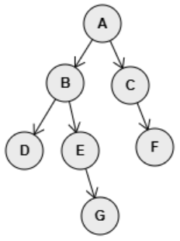
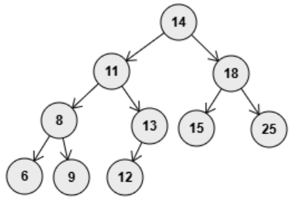
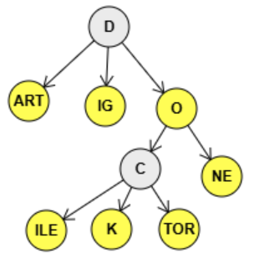
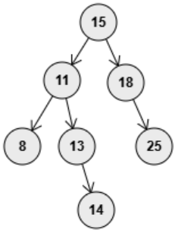
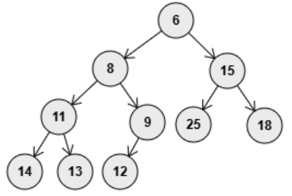
Basic Data Structures
Trees
...of various kinds
Binary tree: Each node has at most two children..
ReTRIEval tree: Each node contains an n-gram of characters. Words are formed from root to word terminal nodes (internal or leaves)
Binary search tree: Binary tree where each node is greater than all its left children and smaller (or equal) than all its right children.
Balanced binary search tree: Binary search tree where each level is complete, with the exception of the last level, which is filled from left to right.
Heap tree: Each node is greater (or equal) than all its children. Each level is complete, with the exception of the last, which is filled left to right.
Notes:
A : 149,52 > B C
B : 83,112 > E D F
C : 195,111 > G
D : 36,178 >
E : 94,175 > H I
F : 149,178 >
G : 228,175 > J K L
H : 58,240 >
I : 117,238 >
J : 178,240 >
K : 238,240 >
L : 290,239 >
------------- D : 265,74 > ART O IG
ART : 201,133 >
O : 319,139 > C NE
C : 290,187 > TOR ILE K
TOR : 321,235 >
ILE : 215,236 >
K : 267,235 >
NE : 355,193 >
IG : 262,137 >

Slide 8
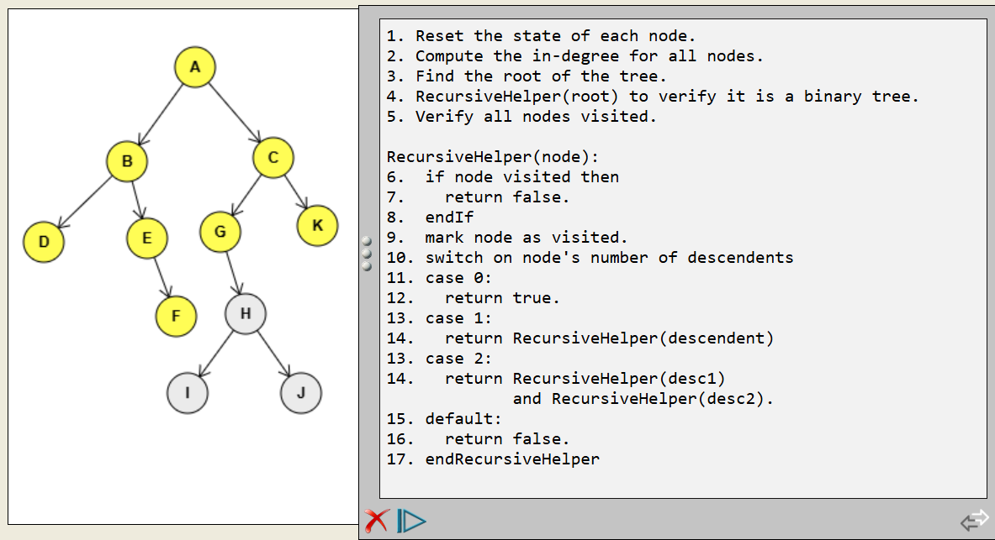
Basic Data Structures
Trees
...a form of specialized Graphs
Determine if a generic Graph is a valid binary tree.
Determine if a generic Graph is a valid binary search tree.
Determine if a generic Graph is a valid heap tree.
Challenge: Generate all words from a TRIE.
Notes:
A : 188,83 > B C
B : 143,144 > D E
C : 232,140 > F
D : 86,219 >
E : 182,212 > G
F : 279,212 > H I
G : 132,284 > J K
H : 221,274 > L
I : 316,276 >
J : 81,350 >
K : 156,342 >
L : 259,341 >

Slide 9
Basic Data Structures
Queues and Stacks
GPT/Copilot ⟩ What are the common traits of queues as stacks data structures?
Queues and Stacks are both fundamental linear data structures in computer science, each with unique characteristics and operations.
Common traits:
Linear Structures: Both stacks and queues store elements in a sequential manner.
Dynamic Size: Both can dynamically grow or shrink in size as elements are added or removed.
Basic Operations: Both support basic operations like adding, removing, peeking (viewing the next element to be removed, without actually removing it) and empty check (verify if they are empty)
Differences:
Primary Operations: Queue = { enqueue, dequeue, peek, isEmpty } Stack = { push, pop, peek, isEmpty }
Order of Operations: Queue = Last-In-First-Out (LIFO), Stack = First-In-First-Out (FIFO)
Use cases:
Stack: Function-call management, Expression evaluation, Backtracking algorithms (like maze solving).
Queue: Task scheduling (Operating Systems), Breath-First path finding in graphs, buffering & caching.
Notes:
6 : 36,82 >
* : 85,36 > 6 +
+ : 134,88 > 3 /
3 : 89,132 >
/ : 173,138 > 8 -
- : 217,198 > 7 3
8 : 134,194 >
7 : 180,259 >
3 : 264,260 >

Slide 10
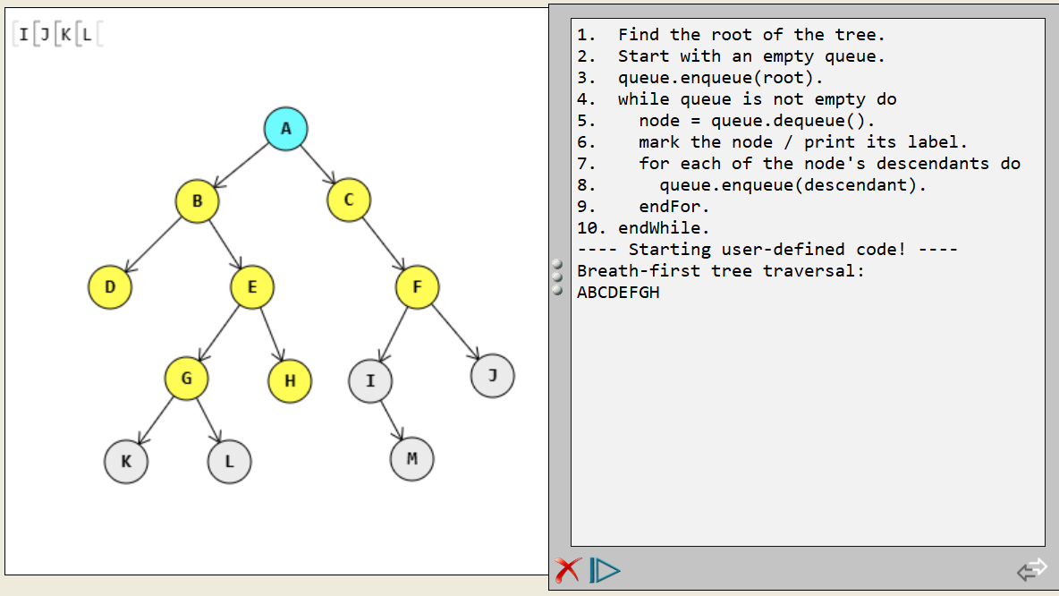
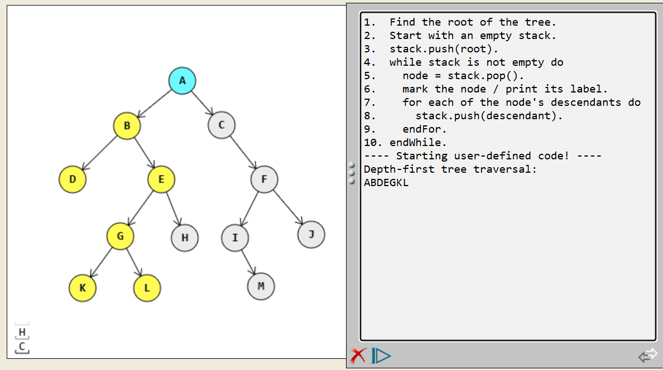
Basic Data Structures
Tree traversal
...using queues and stacks
Traverse a binary tree, level by level, from left to right.
Traverse a binary tree, branch by branch, from left to right.
Challenge: print the prefix form of an arithmetic expression.
Challenge: print the postfix form of an arithmetic expression.
Notes:
1. Find the root of the tree.
2. Start with an empty stack.
3. stack.push(root).
4. while stack is not empty do
5. node = stack.pop().
6. mark the node / print its label.
7. for each of the node's descendants do
8. stack.push(descendant).
9. endFor.
10. endWhile.
----------
A : 209,90 > B C
B : 143,144 > D E
C : 256,143 > F
D : 78,208 >
E : 184,208 > G H
F : 307,208 > I J
G : 135,276 > K L
I : 272,278 > M
J : 363,274 >
K : 90,338 >
L : 167,338 >
M : 303,336 >
H : 212,278 >
----[ (5 + 8*4 / (15 + 1)) * 3 ]----
+#1 : 231,230 > 15 1
15 : 194,279 >
1 : 277,279 >
/ : 160,175 > *#1 +#1
*#1 : 114,220 > 8 4
8 : 68,276 >
4 : 152,278 >
+#2 : 94,125 > 5 /
5 : 39,175 >
*#2 : 157,69 > +#2 3
3 : 224,130 >
----[ 5 * (6 – (3 + 8) / 2) ]----
+ : 246,240 > 3 8
3 : 196,314 >
8 : 287,314 >
/ : 296,166 > + 2
2 : 342,238 >
- : 260,92 > 6 /
6 : 214,164 >
* : 206,32 > 5 -
5 : 167,89 >
----[ 5 / 3 * (7 - 5 * (3 / 2 - 1) + 7) * (4 - 2 / (8 - 6)) ]----
8 : 236,254 >
6 : 287,254 >
-#1 : 254,212 > 8 6
/#1 : 219,169 > 2#1 -#1
2#1 : 202,210 >
-#2 : 184,131 > 4 /#1
4 : 168,172 >
*#1 : 138,90 > + -#2
3#1 : 94,334 >
2#2 : 137,334 >
/#2 : 121,292 > 3#1 2#2
1 : 169,290 >
-#3 : 144,248 > /#2 1
*#2 : 119,203 > 5#1 -#3
5#1 : 92,247 >
-#4 : 88,170 > 7#1 *#2
7#1 : 64,203 >
+ : 117,132 > -#4 7#2
7#2 : 139,171 >
5#2 : 31,130 >
3#2 : 75,131 >
/#3 : 58,93 > 5#2 3#2
*#3 : 92,54 > /#3 *#1

